Slide 1
Networking with LOGO! 0BA7 and SIMATIC Controller
+ How to configure Networking
+ How to simulate Networking

Slide 2
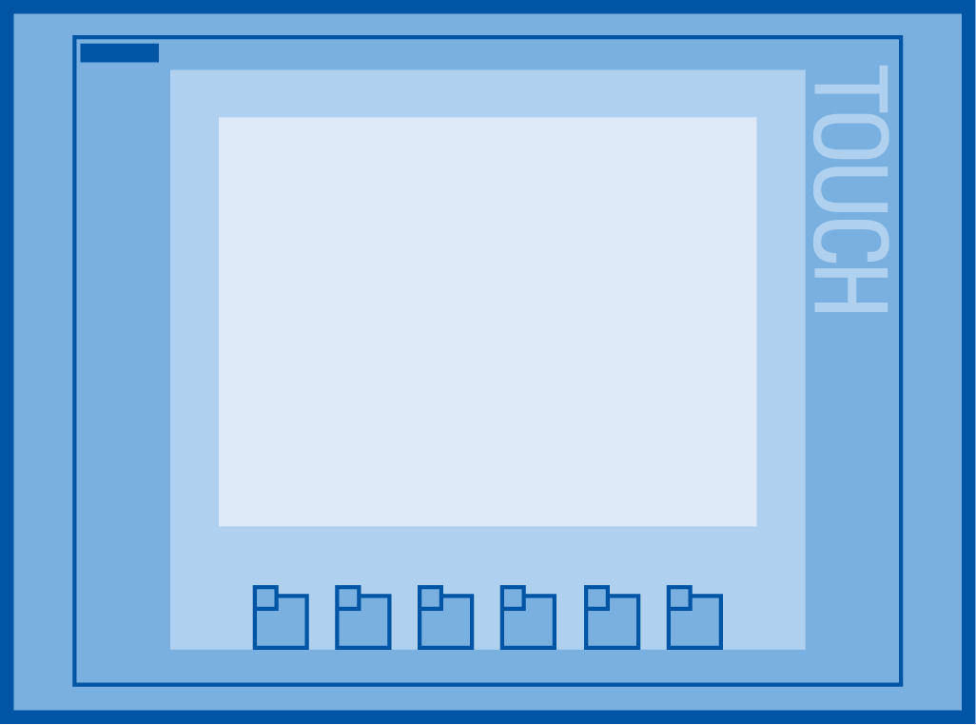
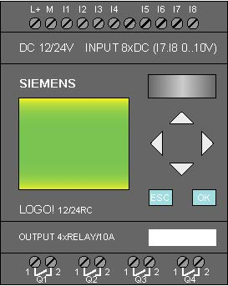
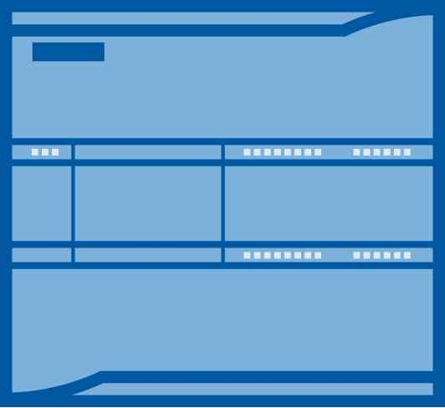
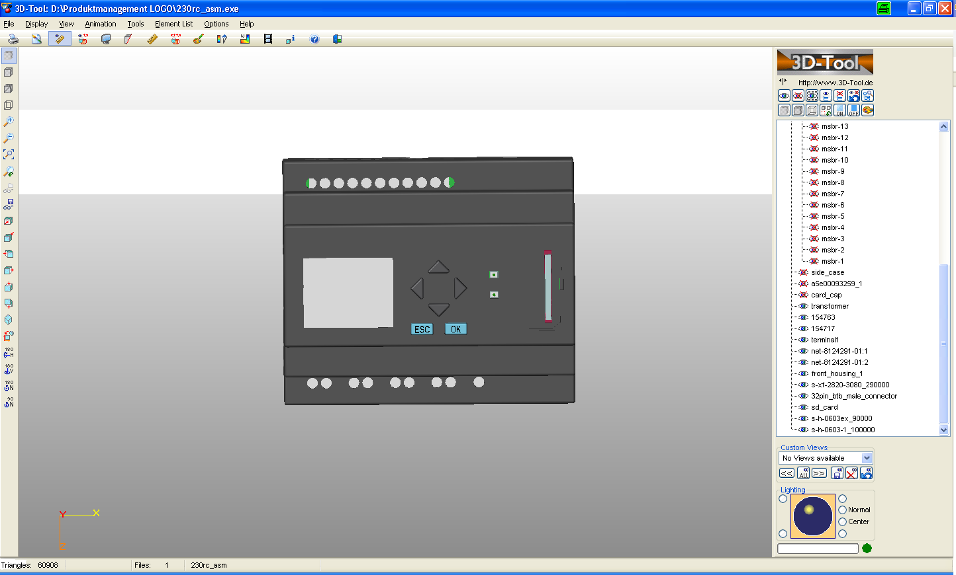
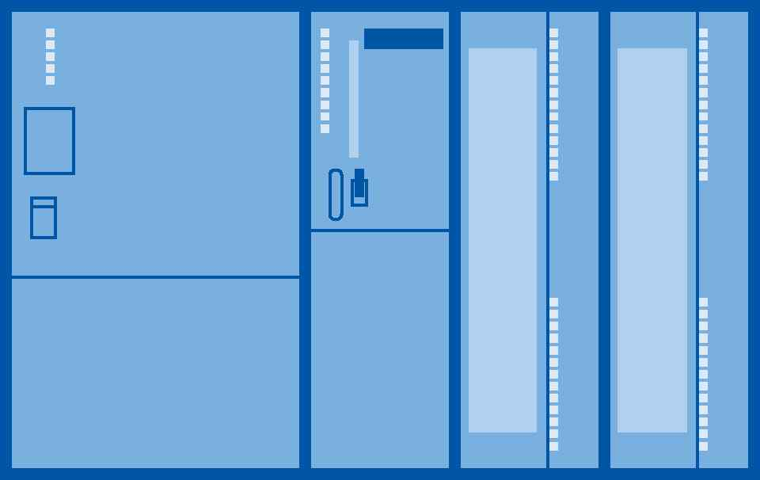

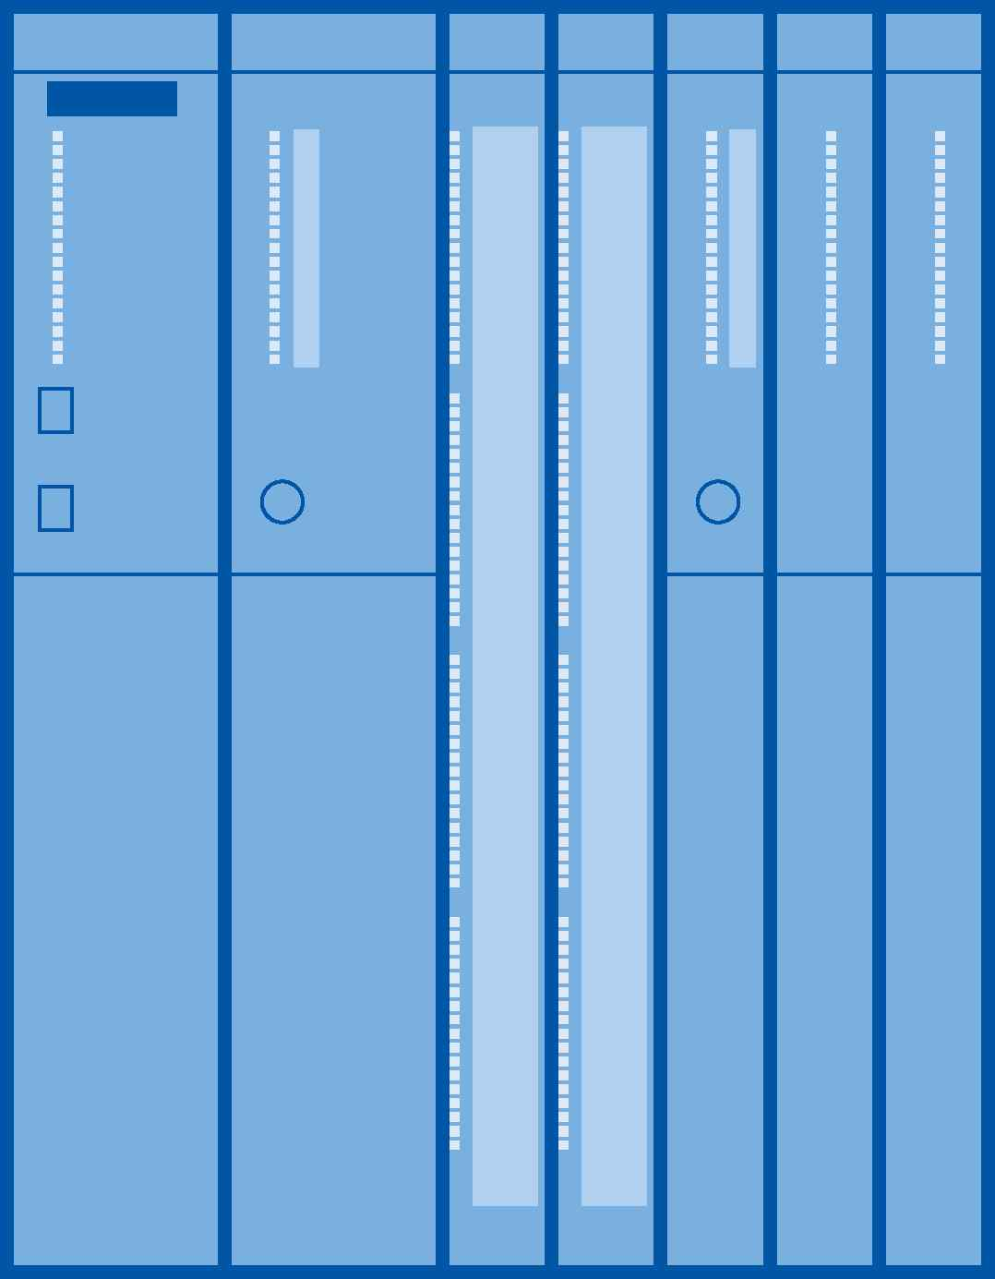

Networking with LOGO! 0BA7 and LSC V7
Siemens HMI
SIMATIC Controller
E
E
E
E
PG/PC

Slide 3
Networking with LOGO! 0BA7 and LSC V7
LOGO! 0BA7
Connect to existing infrastructure
Exchange data to other Siemens devices such as:
+ Siemens HMI
+ SIMATIC Controller (S7-200, 1200, 300, 400, ..)
+ PC/PG via OPC-Server
Exchange data between LOGO! 0BA7 devices
  Remote programming & diagnostic
“Gateway” between EIB/KNX and SIMATIC

Slide 4
Networking with LOGO! 0BA7 and LSC V7
E
E
LOGO! 0BA7
8 + 1 connections supported
8 Channels Server/Client, 1 reserved for LOGO! Soft Comfort
At the same time data exchange from/to
+ LOGO! Slave (Remote IO)
+ LOGO! Master
+ Siemens HMI
+ SIMATIC Controller
+ PG/PC via OPC
is possible

Slide 5
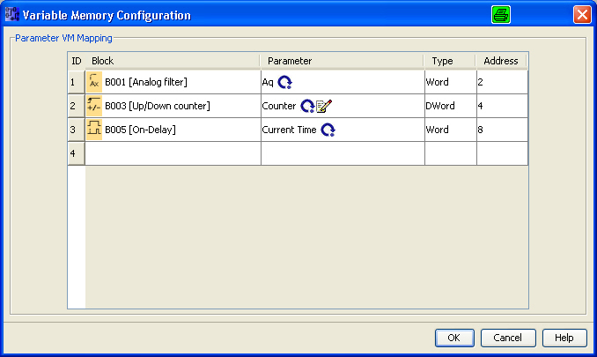
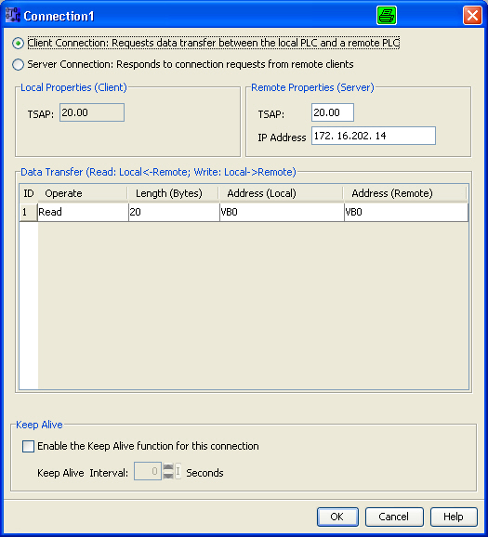

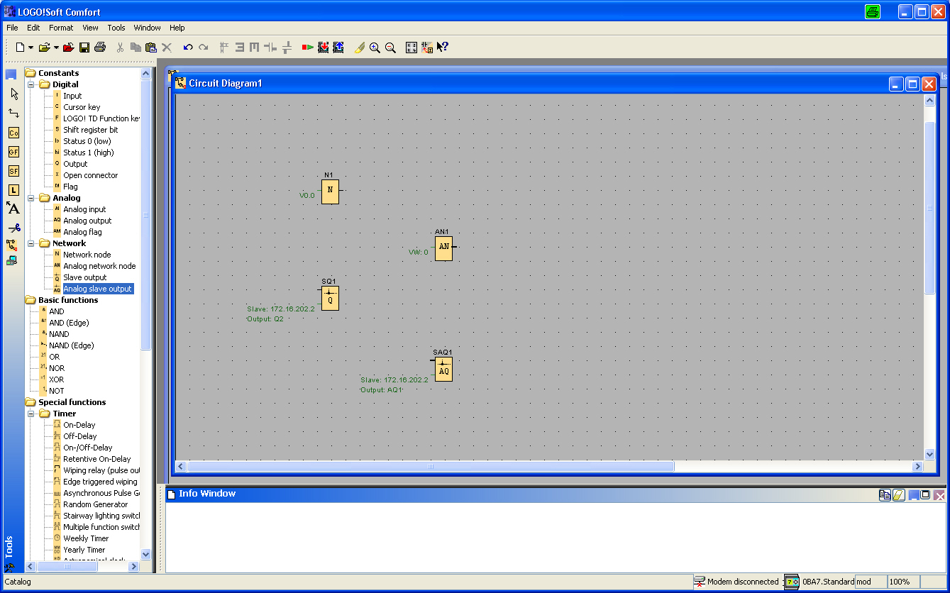
Networking with LOGO! 0BA7 and LSC V7
Parameter VM-Mapping
Siemens HMI
SIMATIC Controller
E
E
Client configuration
Function blocks
PG/PC
(OPC-Server)
ADR. DBx,DBWy

Slide 6
Networking with LOGO! 0BA7 and LSC V7
Siemens HMI
Parameter VM-Mapping
SIMATIC Controller
E
E
Function blocks
LOGO! 0BA7 “acts” as a SIMATIC S7-200.
So DB1 has to be addressed to read/write data from/to LOGO! From other SIMATIC devices.

Slide 7
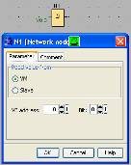
Networking with LOGO! 0BA7 and LSC V7
Siemens HMI
Client configuration
SIMATIC Controller
E
E
PG/PC
(OPC-Server)
ADR. DBx,DByaaa
From a SIMATIC controller data from any DB can be transferred to LOGO!0BA7
Address local
VB0 …850
Notes:
Max. Data:
Max. 8 Clients possible (from 8 controllers)
32 transfers (Lines) per Client channel
Max. 212 Bytes per line
8 * 32 *212 = 54272 Bytes
Each transfer (independent of the specified data amount) requires 150 ms.
So the max. required time is:
8 * 32 * 150ms = 38,4 s
→ We recommend to only use one SIMATIC controller

Slide 8
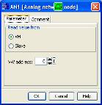
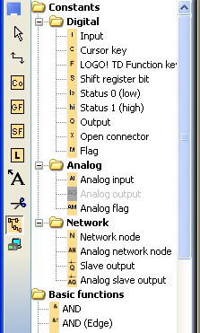

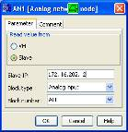
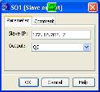
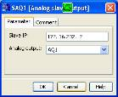
Networking with LOGO! 0BA7
Network note
READ (digital signals)
Network
Analog network note
READ Analog signals)
Slave output
WRITE (Digital signals)
Analog Slave output
WRITE (Digital signals)

